Slide 1

Support Vector Machine
Franz Andersch & Niklas Münz

Slide 2
Structure
Introduction
How it works
Hard Margin
Soft Margin
Kernel Trick
Pros and Cons

Slide 3
1. Basic idea of Support Vector Machine
Especially effective in classification (also used for regression)
Find the hyperplane that separates classes with the maximum possible margin
Only the support vectors (datapoints closest to hyperplane) have direct influence on the position of the hyperplane

Slide 4
1. History of Support Vector Machine
Early ideas of a seperating Hyperplane 1936 (R. Fisher)
First SVM algorithm in 1964 (V. Vapnik, A. Chervonenkis)
Use of kernel trick for nonlinear classifiers in 1992 (B. Boser, I. Guyon, V. Vapnik)
Introduction of „soft margin“ in 1995 (C. Cortes, V. Vapnik)

Slide 5
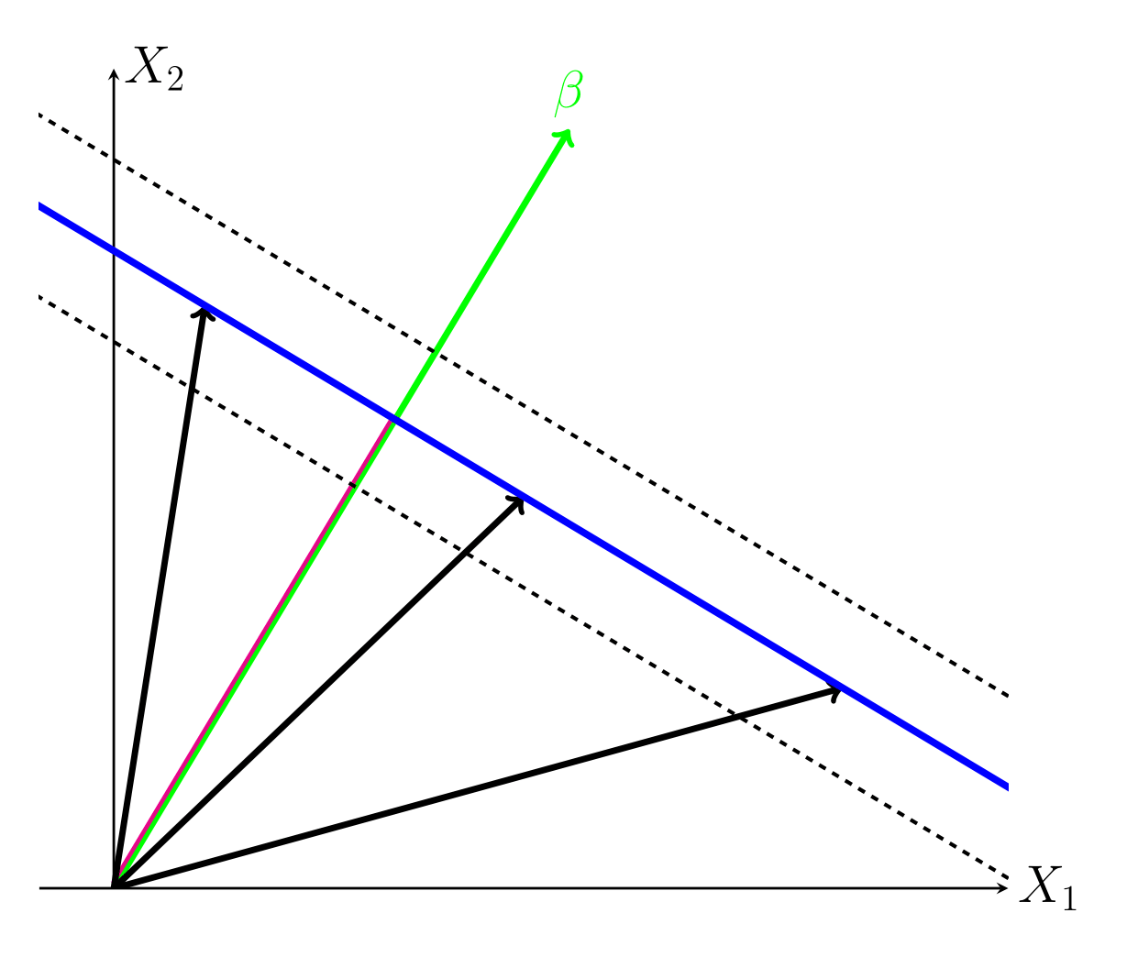
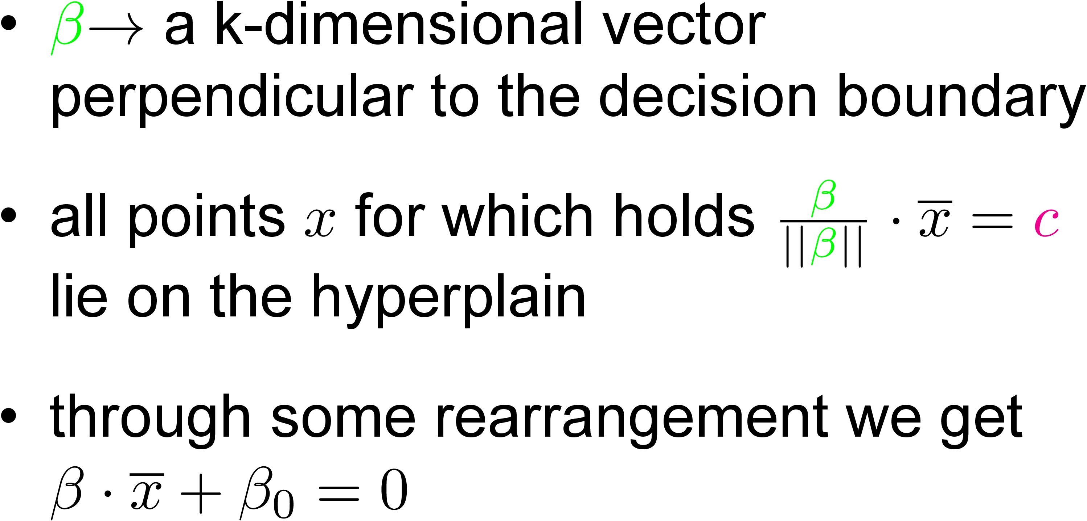
Hard Margin: Decision Boundary

Slide 6
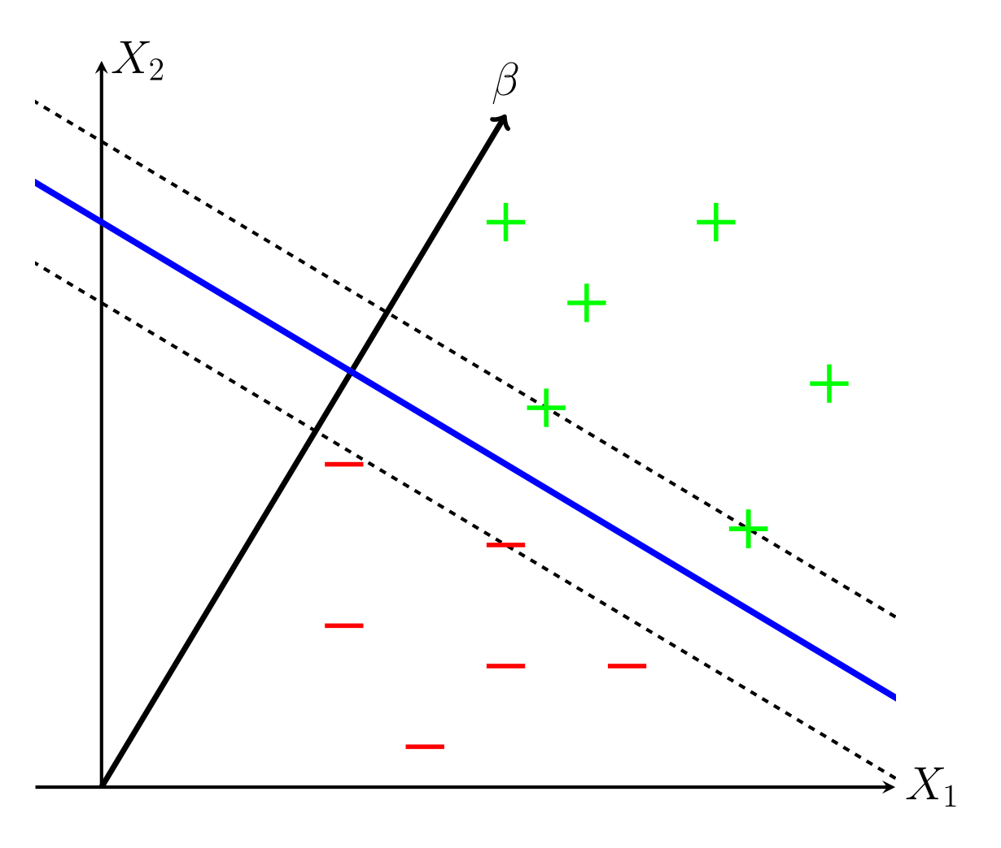
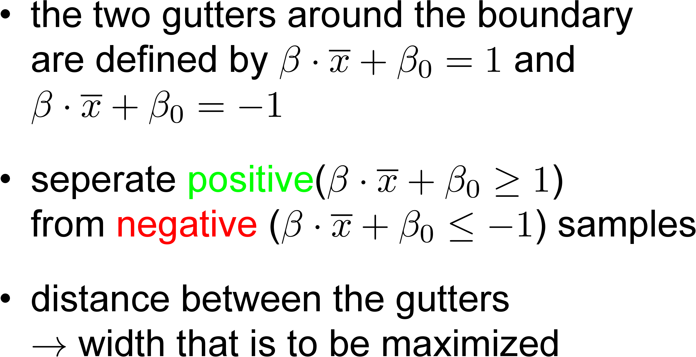
Hard Margin: Decision Boundary

Slide 7
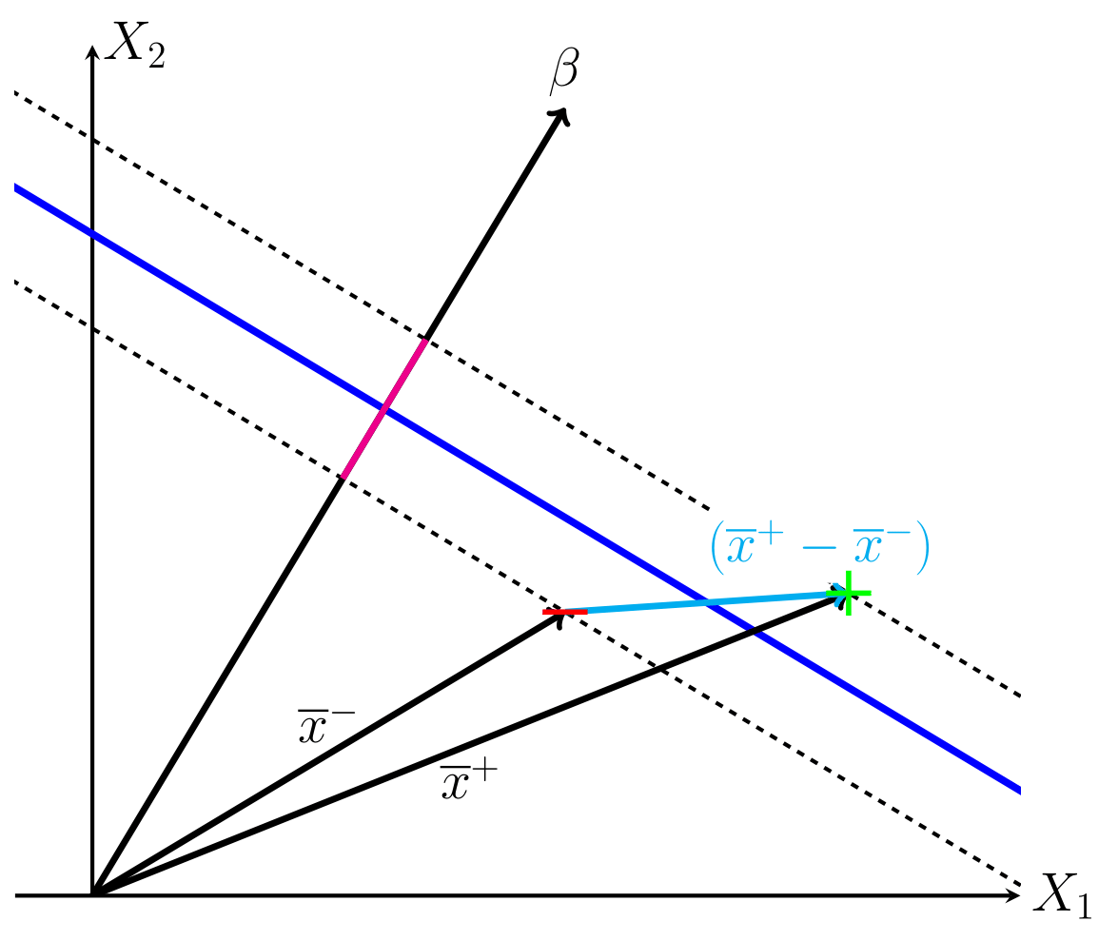
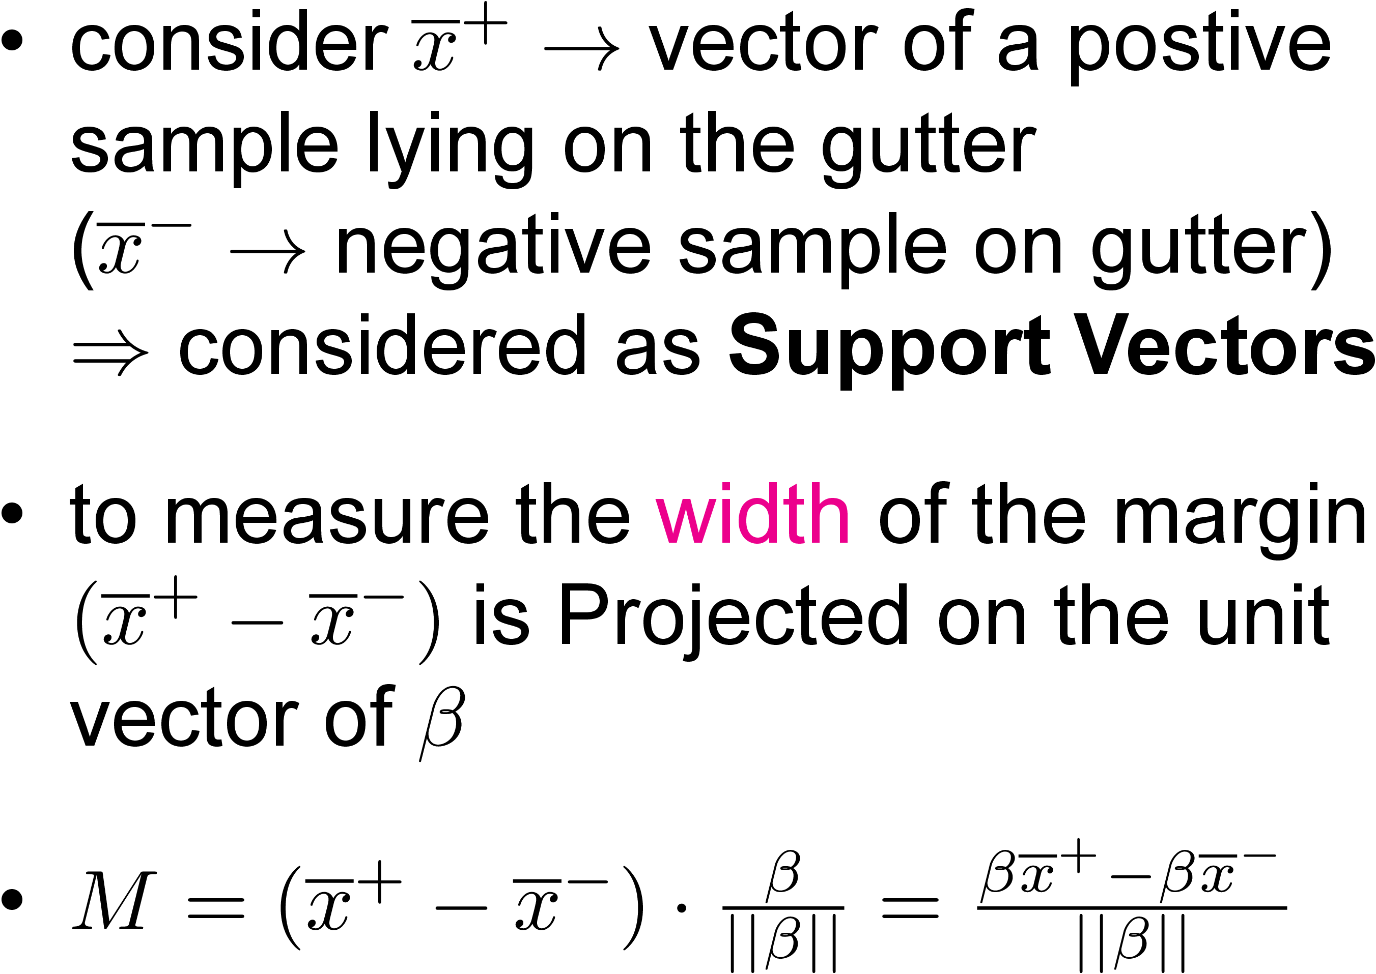
Hard Margin: maximize Margin Width

Slide 8
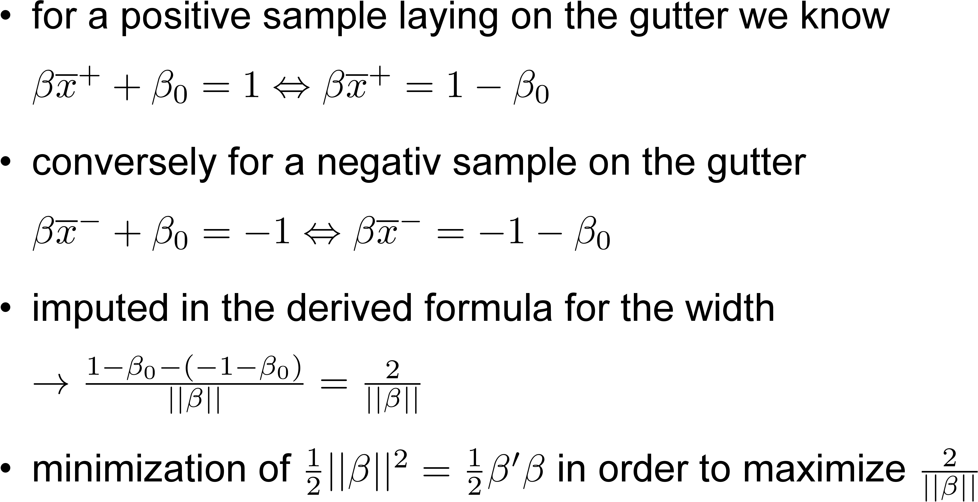
Hard Margin: maximize Margin Width

Slide 9
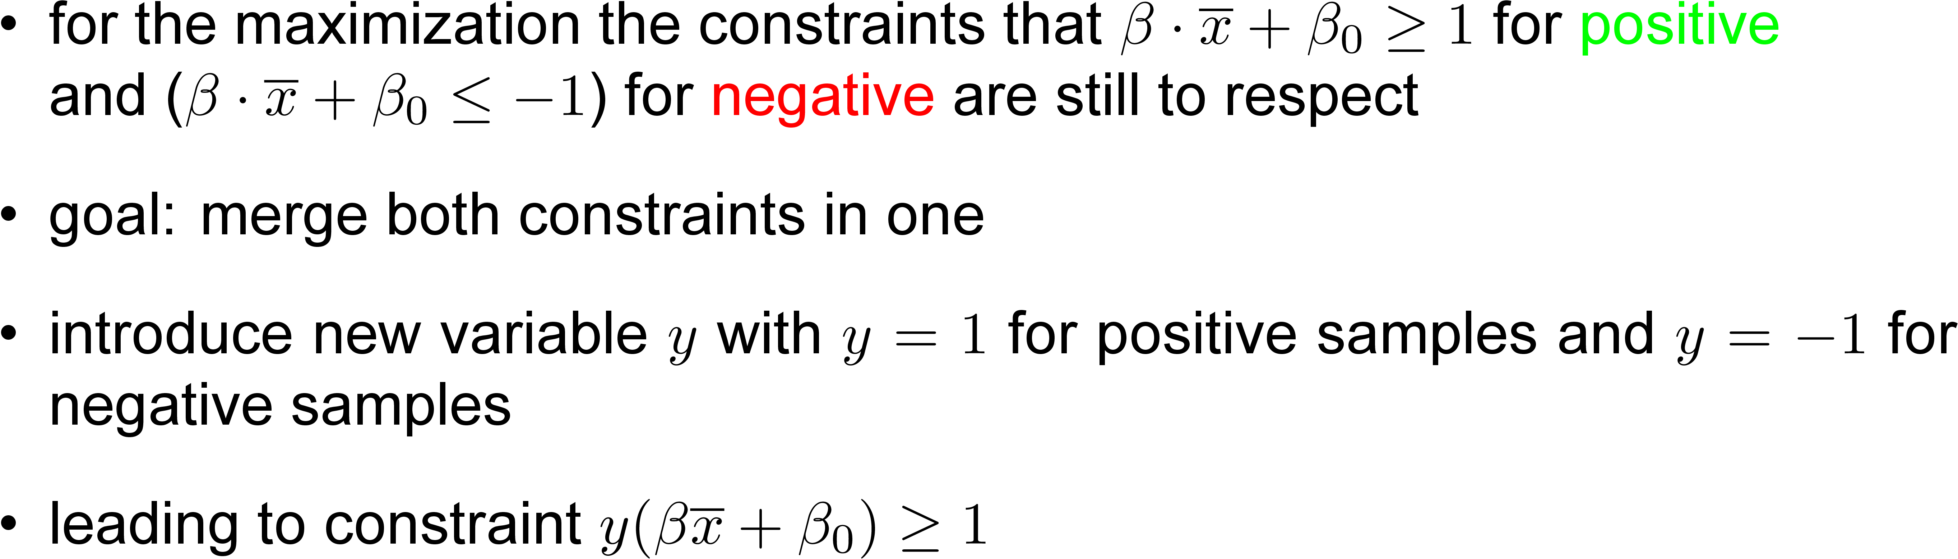
Hard Margin: maximize Margin Width

Slide 10
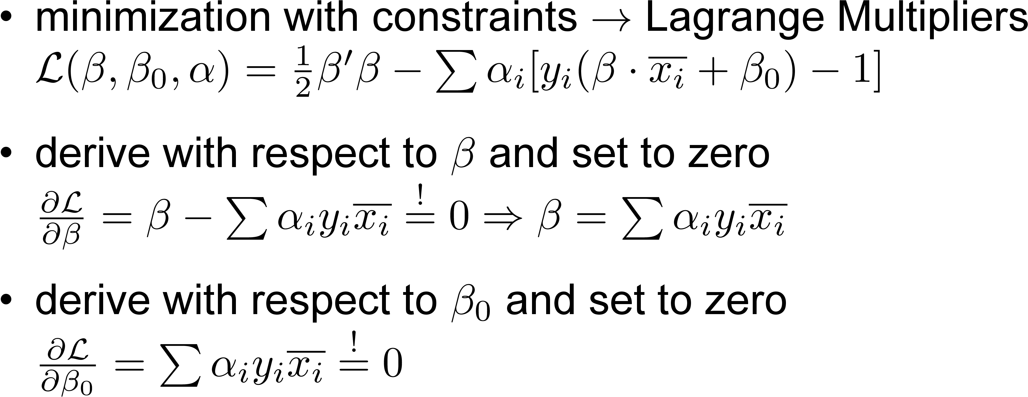
How it works: Maximization Process

Slide 11
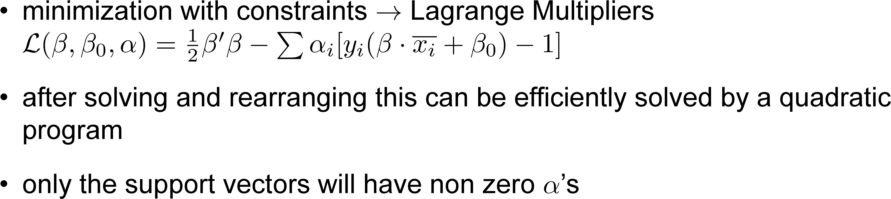
Hard Margin: maximize Margin Width

Slide 12
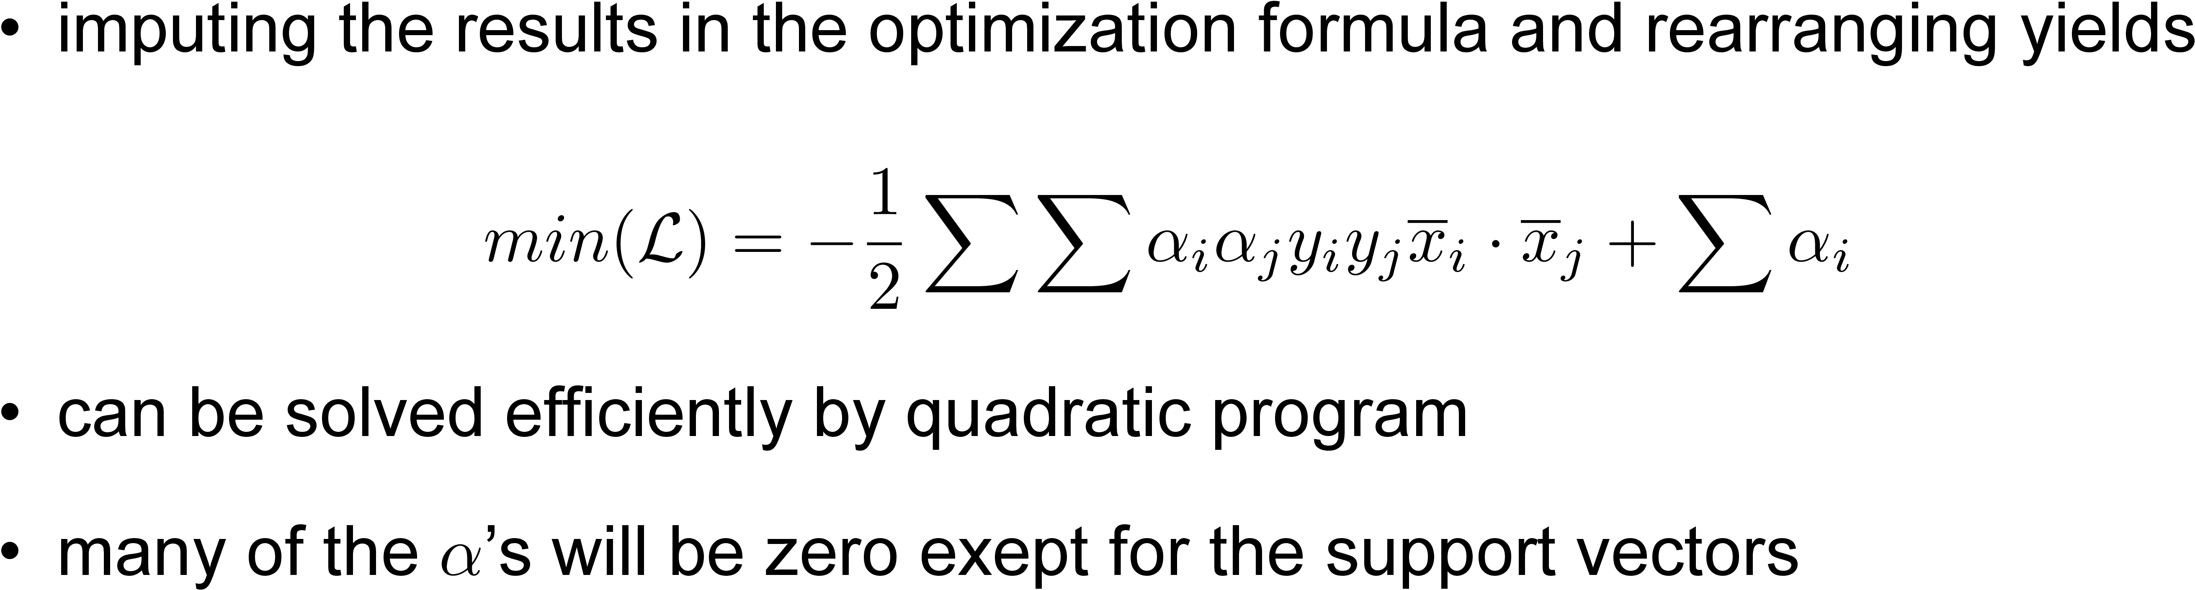
How it works: Maximization Process

Slide 13
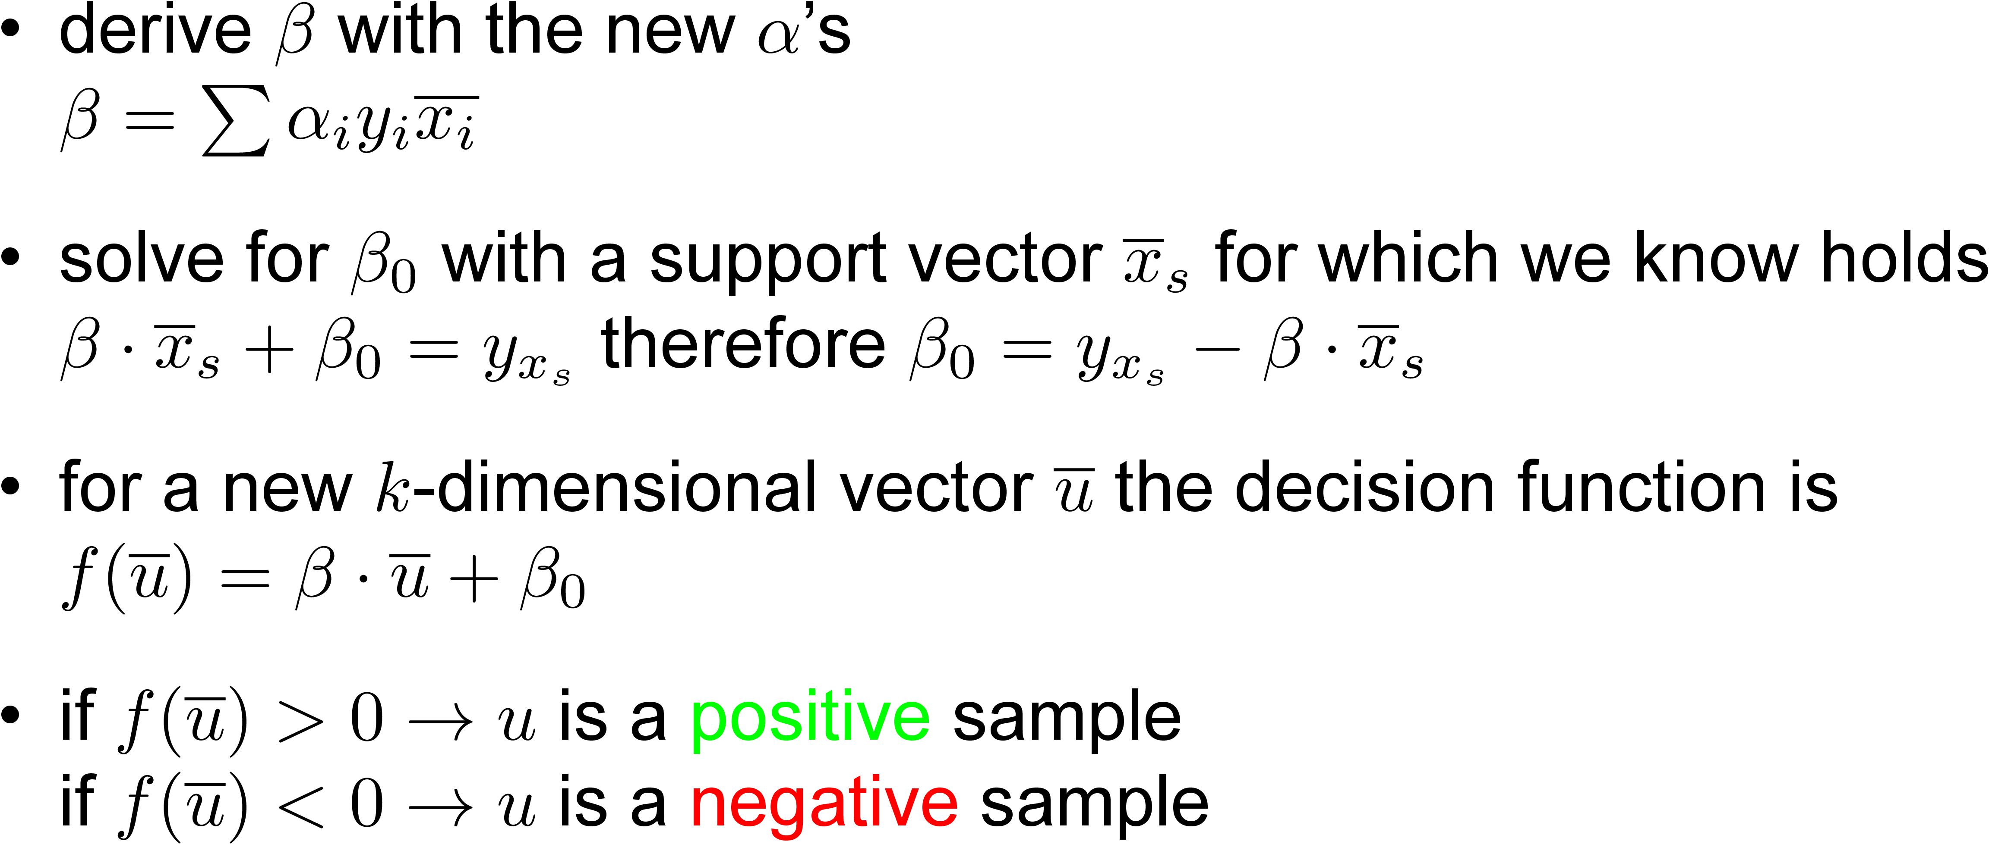
Hard Margin: Decision Rule

Slide 14
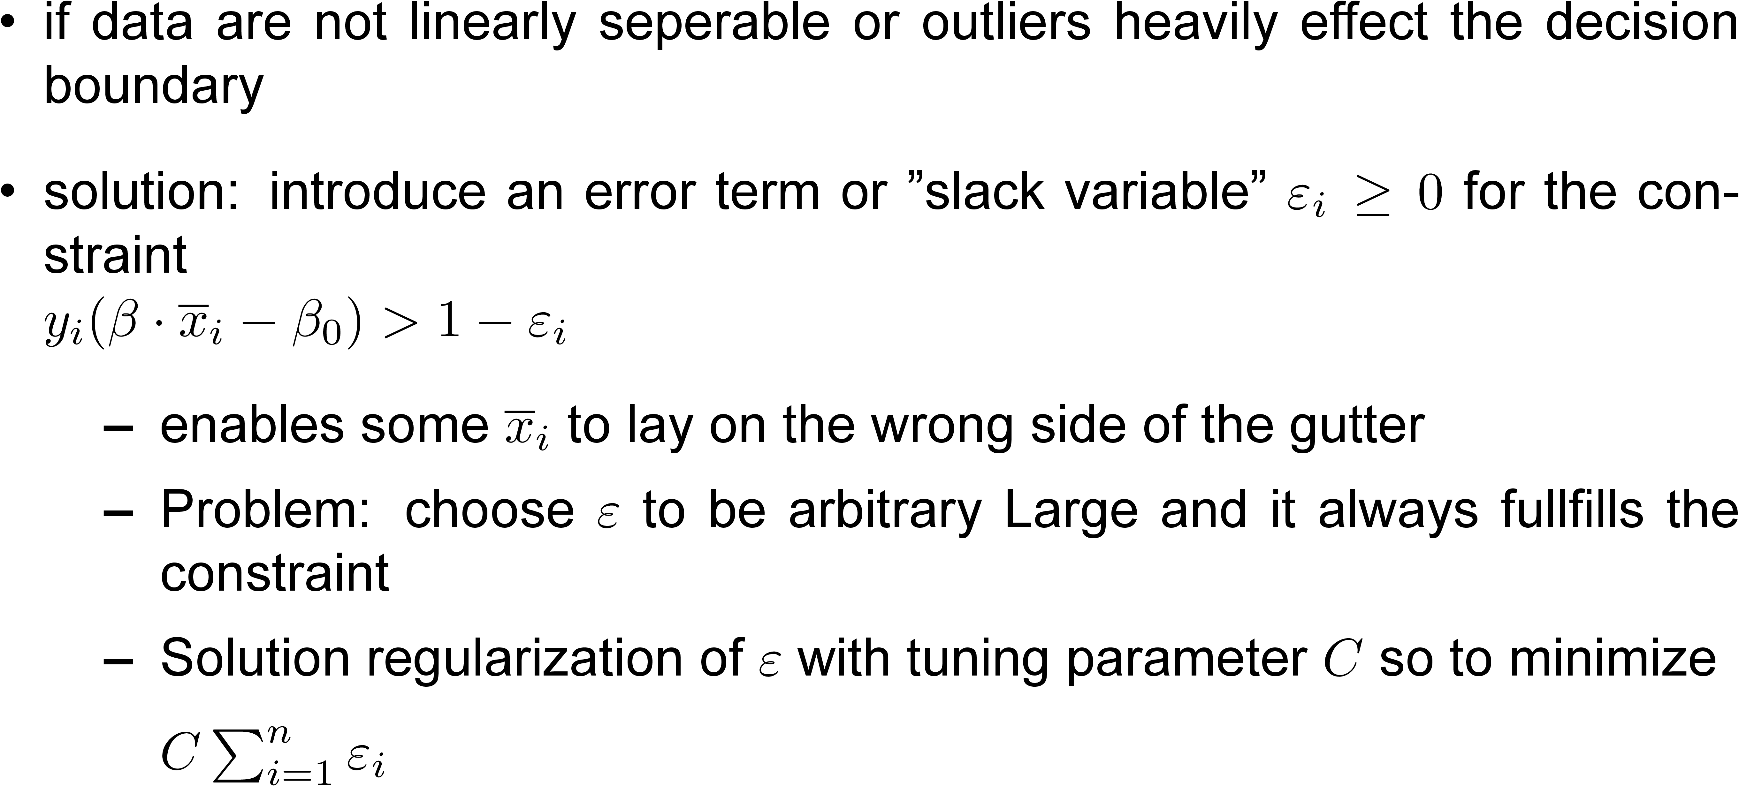
Soft Margin

Slide 15
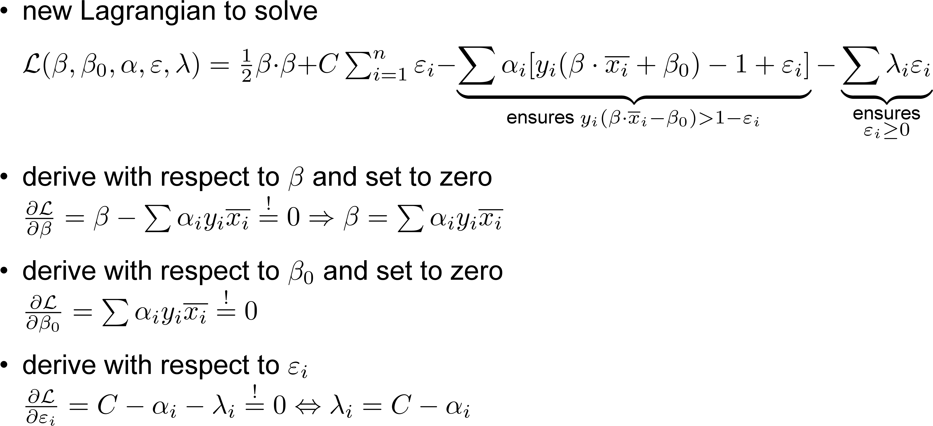
How it works: Soft Margin

Slide 16
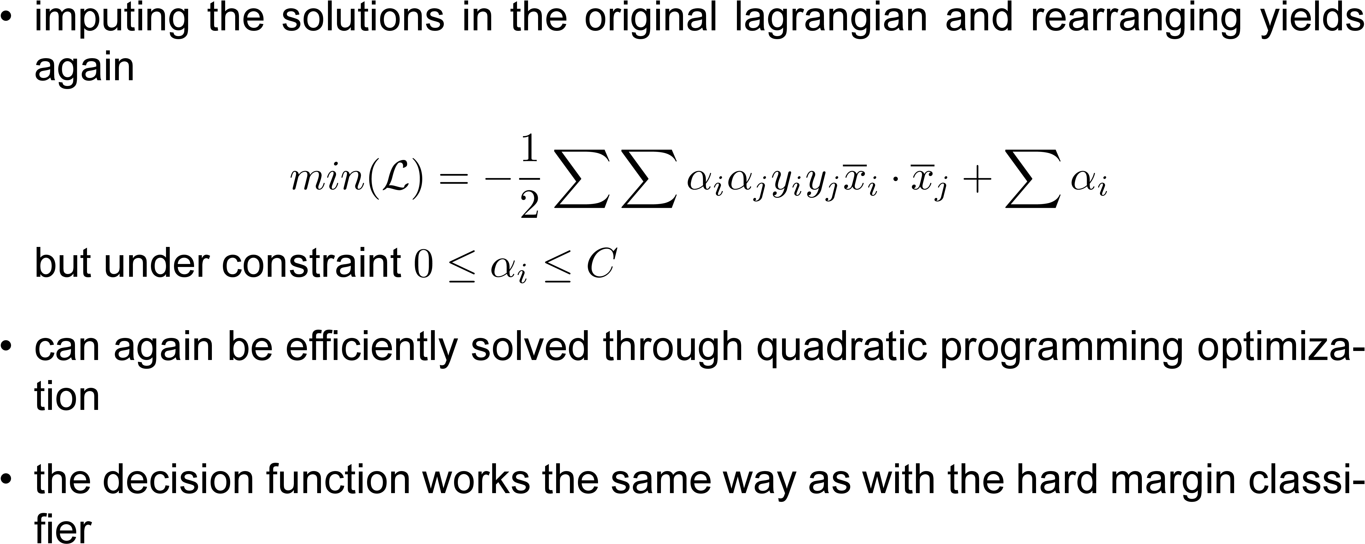
How it works: Soft Margin

Slide 17
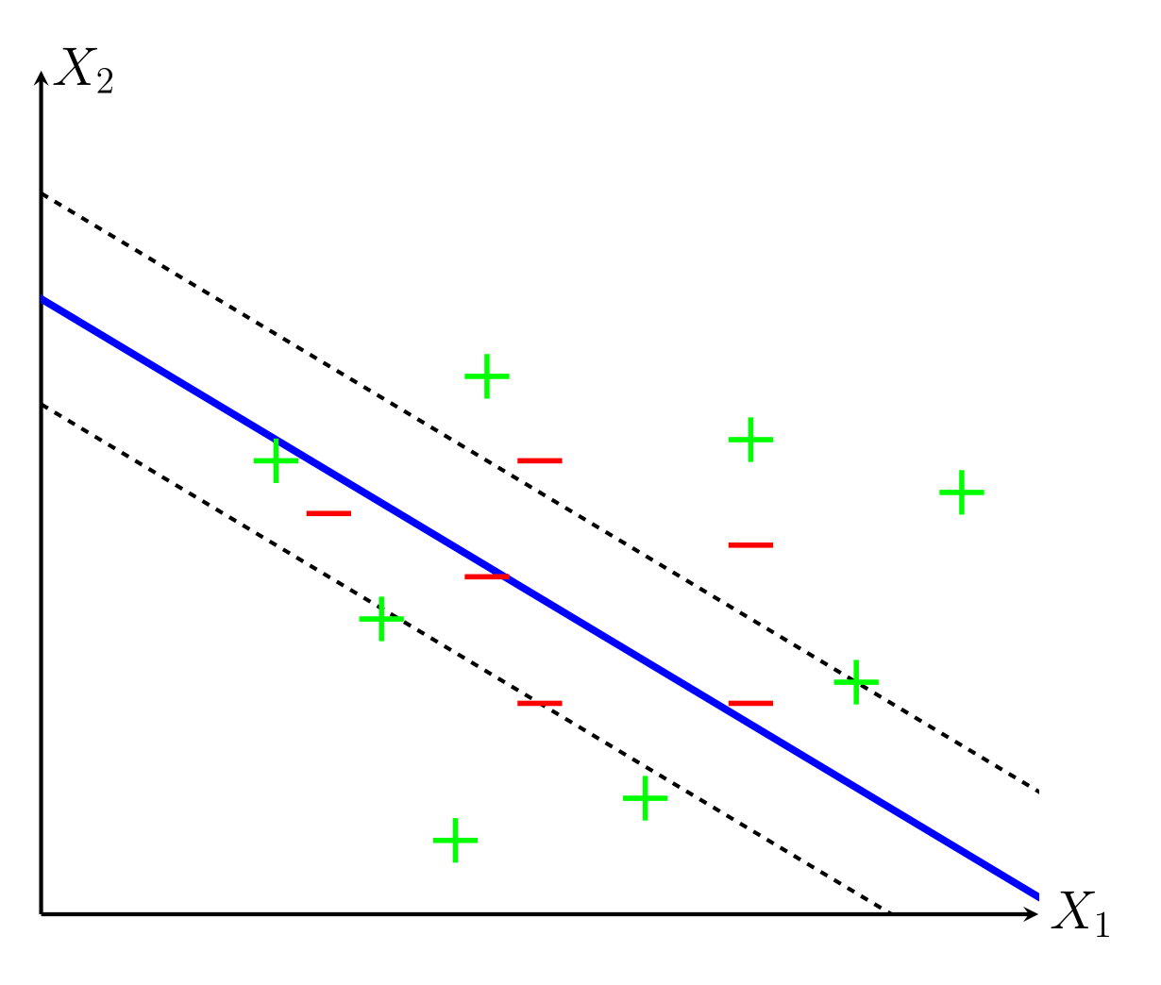
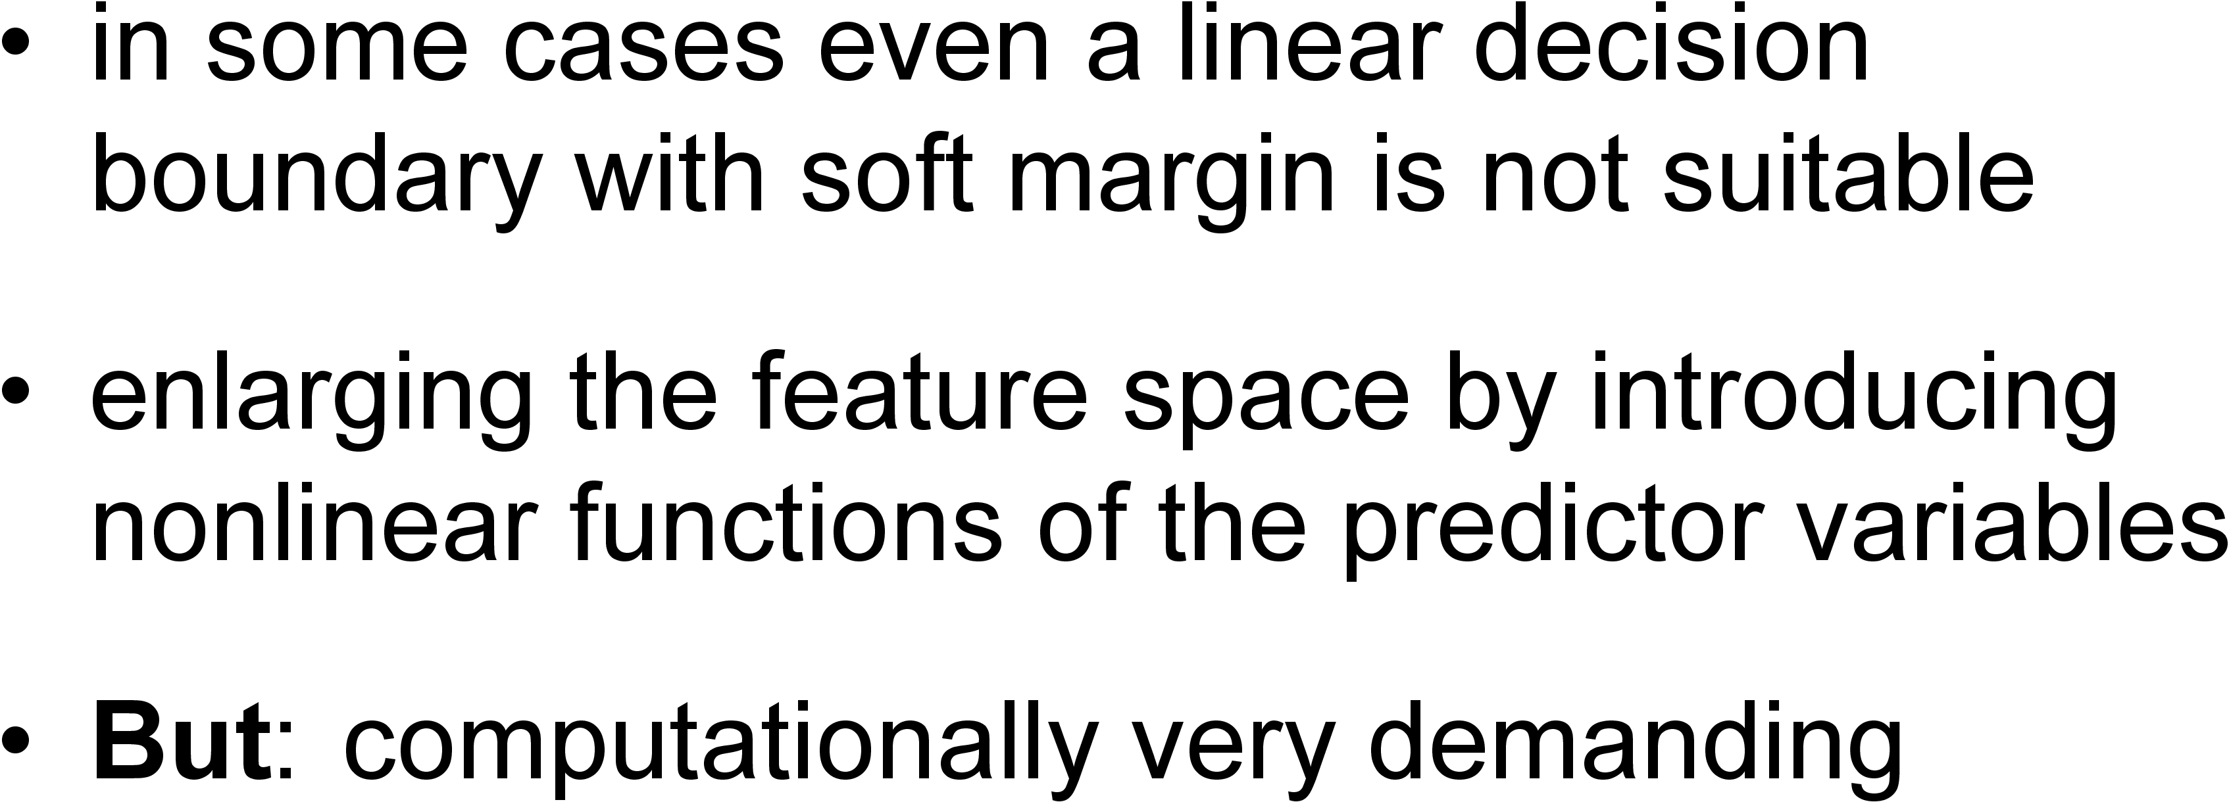
Kernel trick

Slide 18
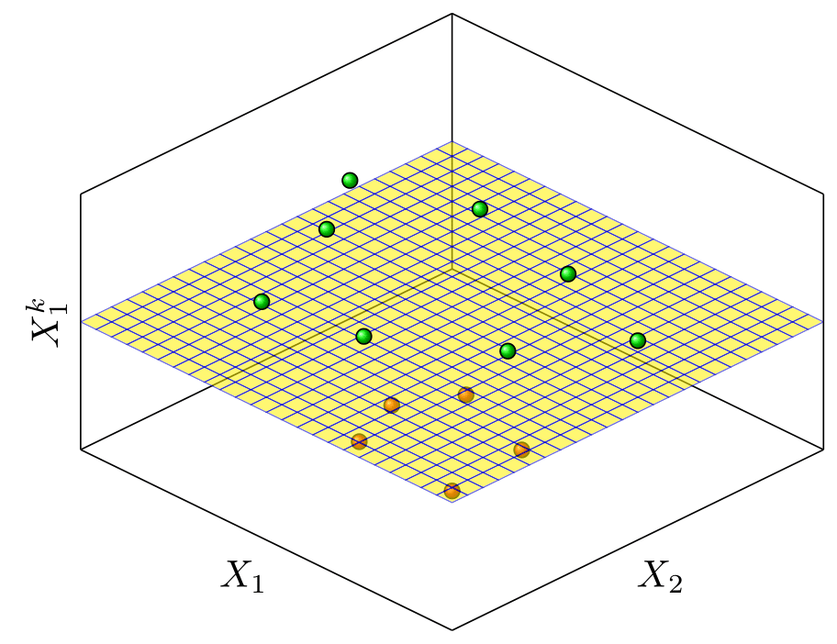
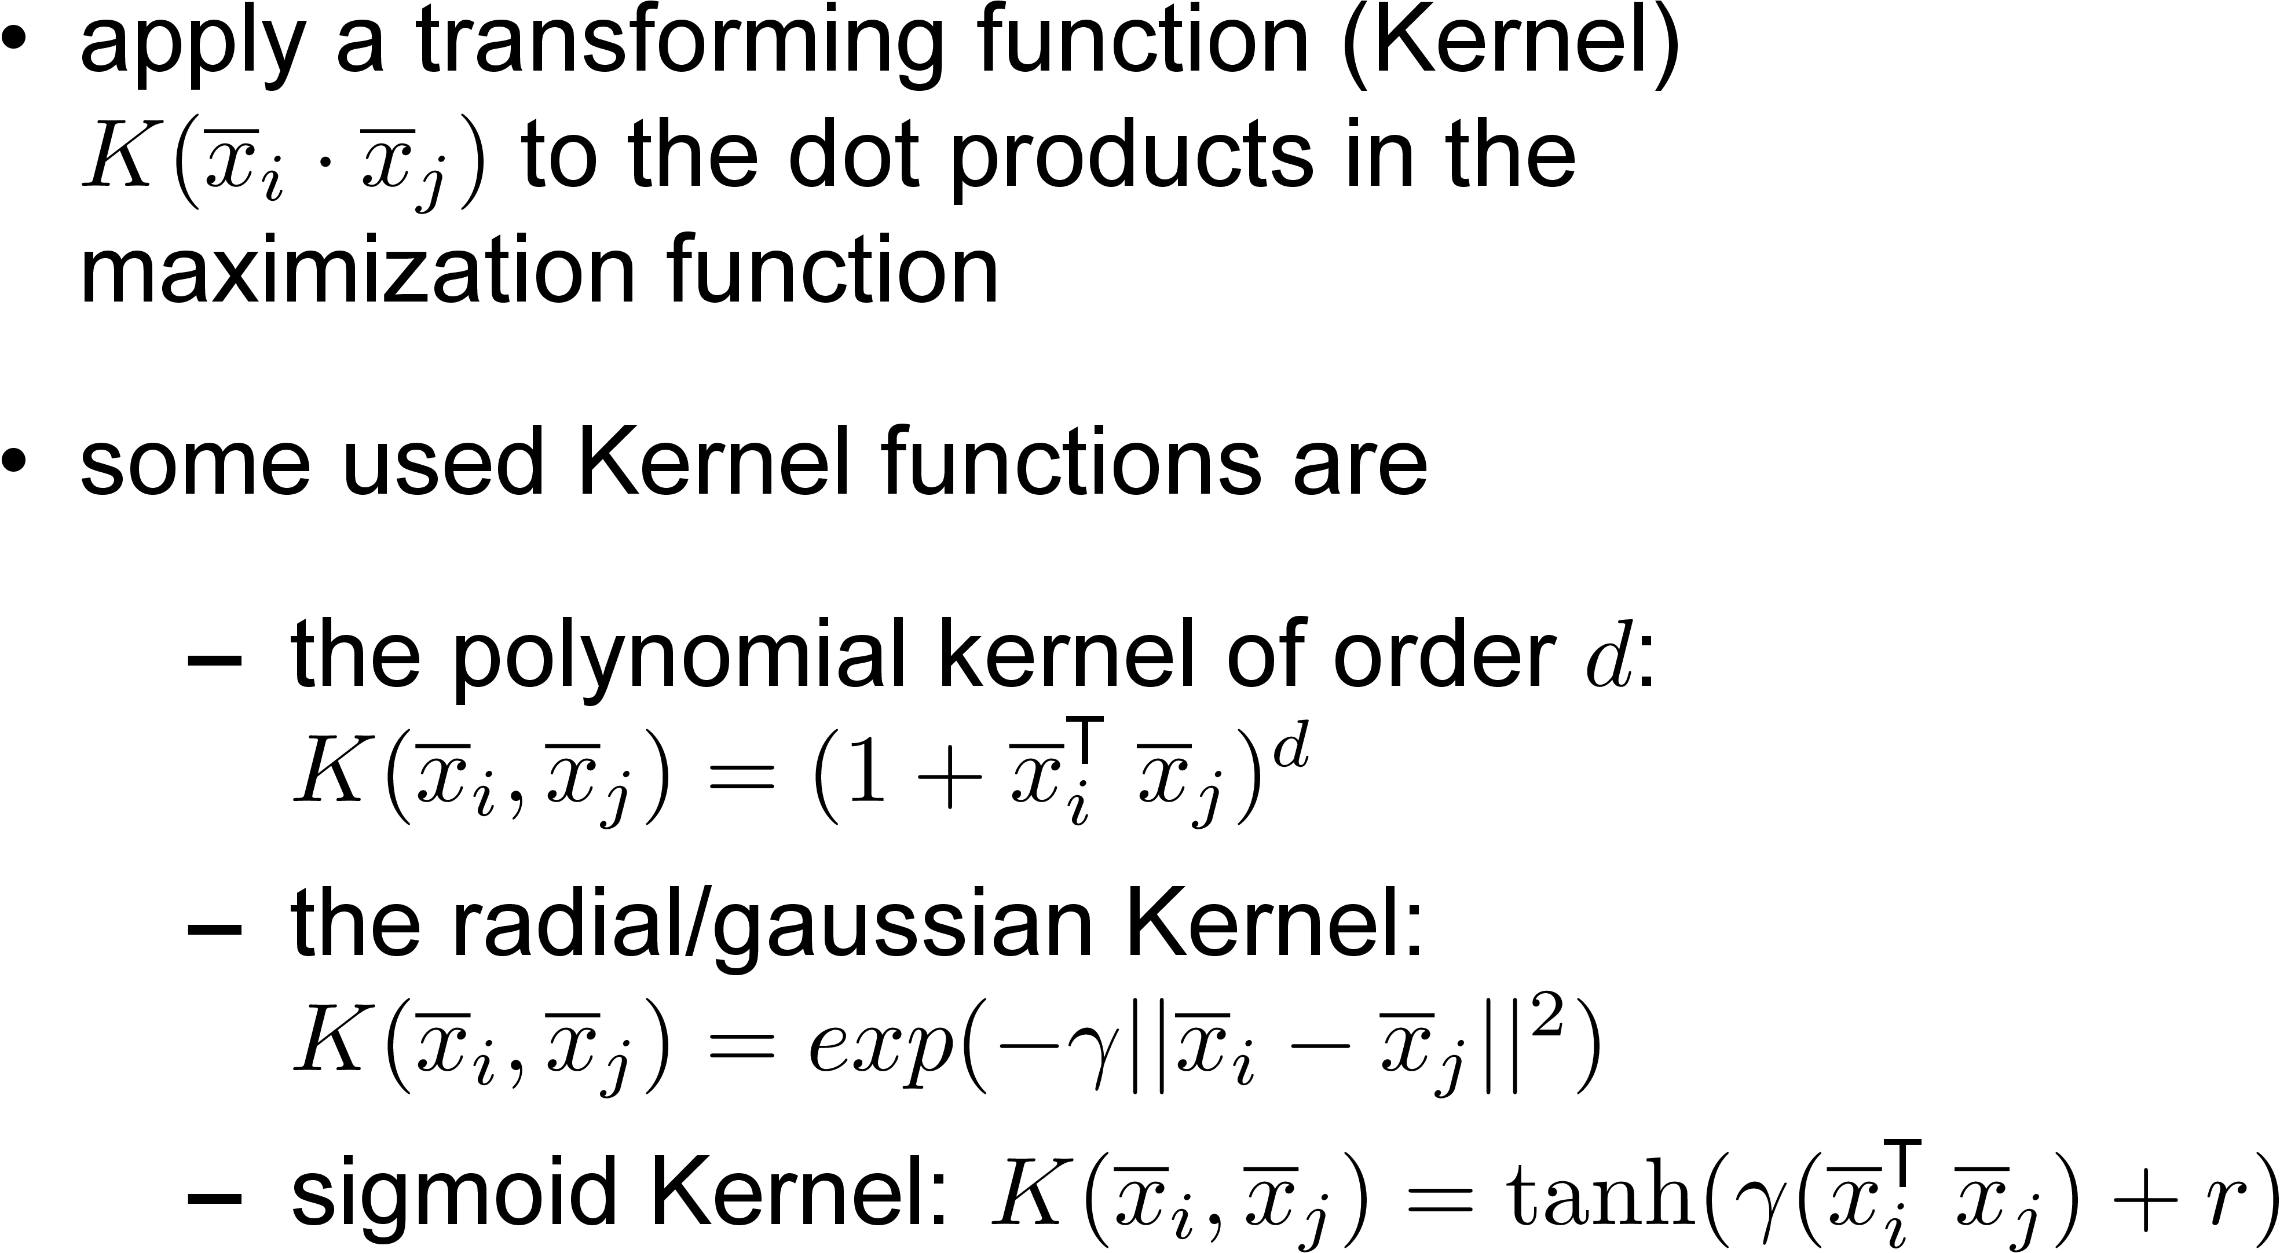
Kernel trick

Slide 19
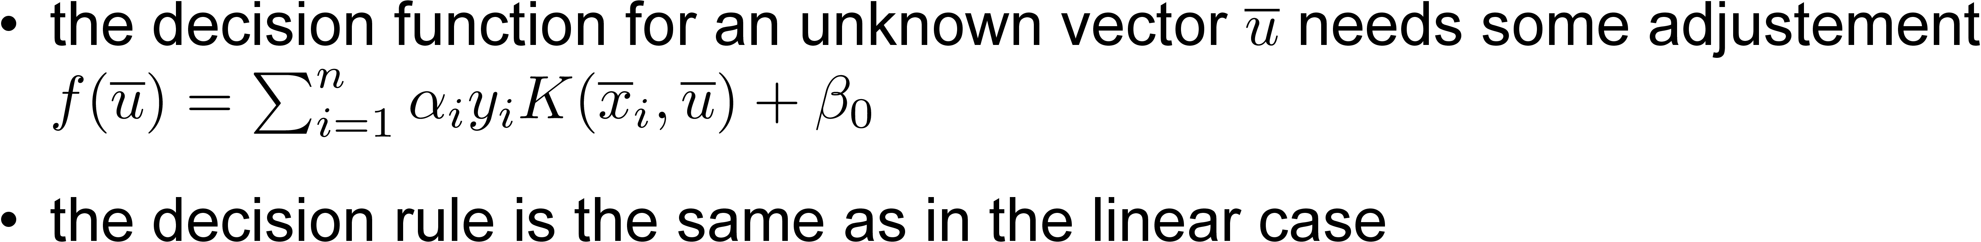
How it works: use of Kernels

Slide 20
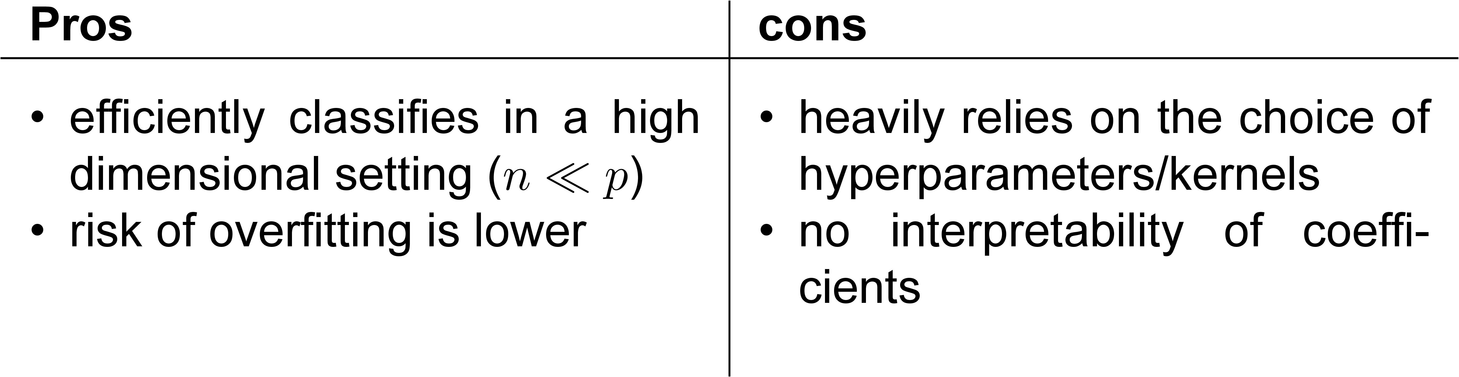
Pros and Cons

Slide 21
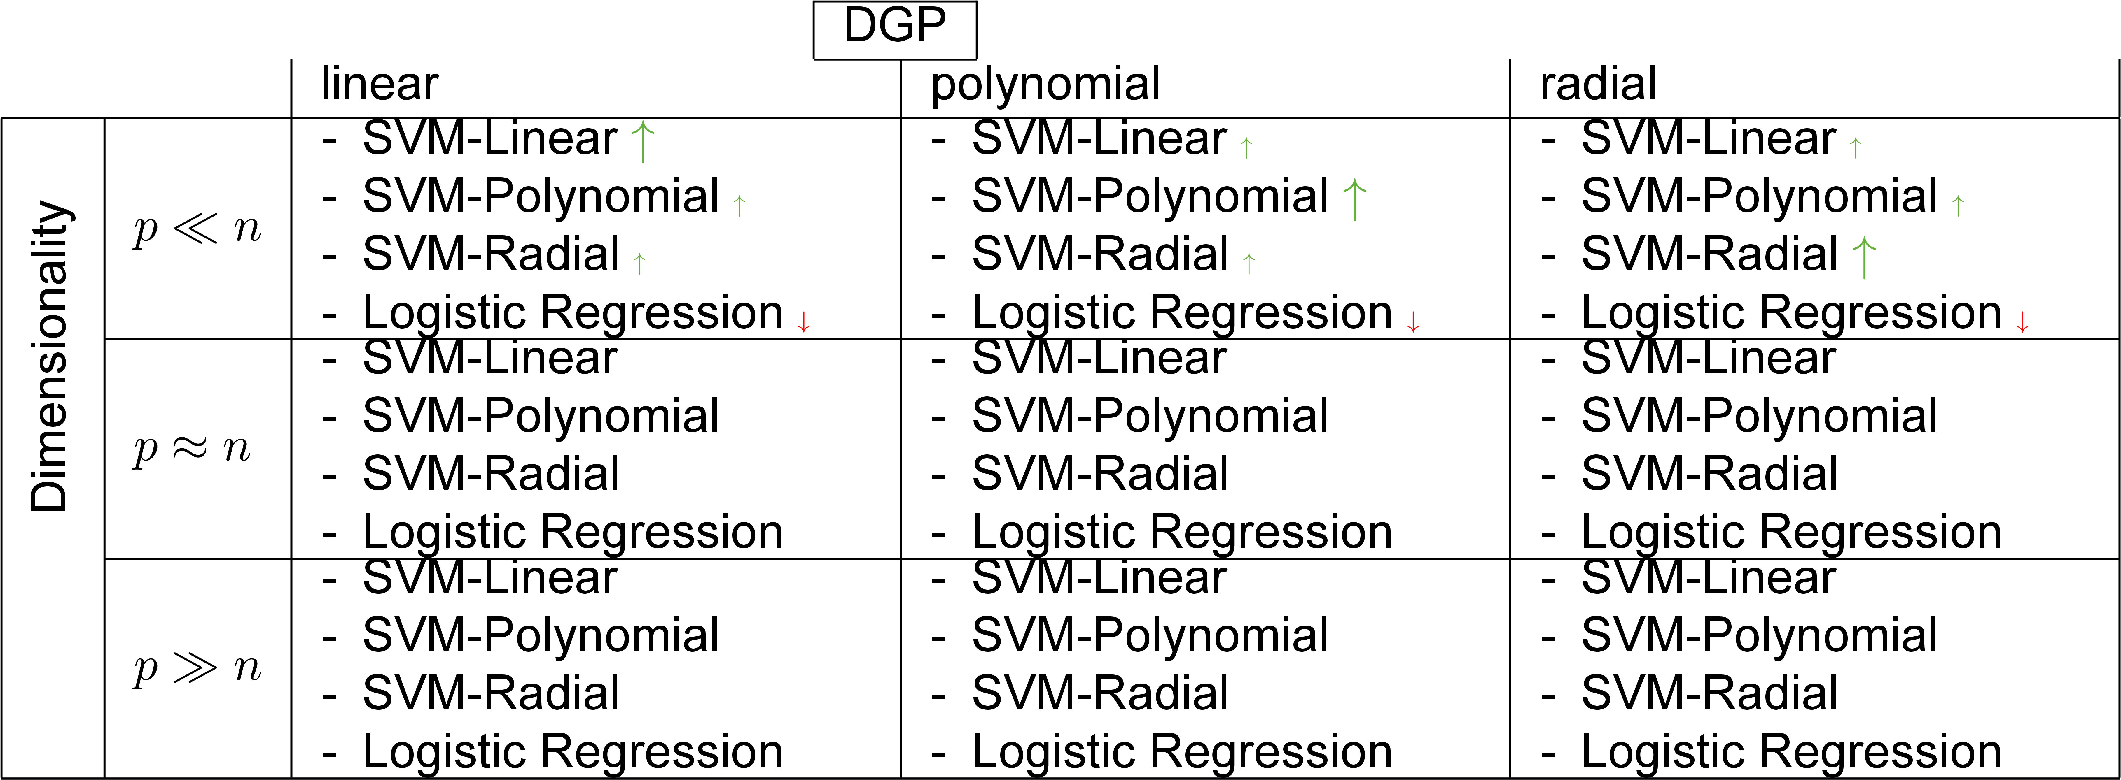
Performance Evaluation

Slide 22
Performance in different Situations

Slide 23
Performance Evaluation

Slide 24
Dataset: ALLBUS
„General population survey of the social sciences“ (Allgemeine Bevölkerungsumfrage der Sozialwissenschaften)
Response Variable:
„Federal state where interviewee lived in youth“
coded to „Youth in East/West Germany“
Predictor Variables:
121 variables concerning attitudes, behavior and social change

Slide 25
Dataset: ALLBUS
Data Preparation:
Only include questions answered in all 3 Splits
Exclude questions with > 5% NA
Exclude observations with NA
After Preparation: 2509 observations and 122 variables

Slide 26
Simulation study
Measurement of accuracy:
Misclassification rate
ROC curve

Slide 27
Eventuell Vergleich zur logistischen Regression

